Slide 1
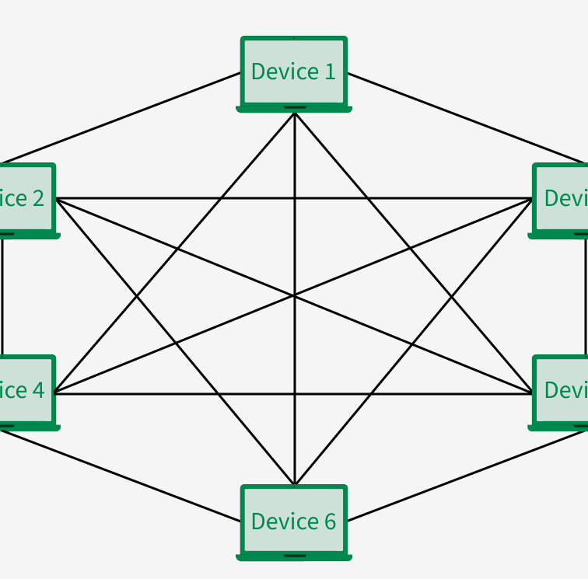
Understanding Mesh Topology
بسم الله الرحمن الرحيم
Aya Mohamed Awaad Ali
ID: 38
Dr/ Reham

Slide 2
Introduction to Mesh Topology
Definition: A network setup where devices (nodes) are interconnected to form a web-like structure.
Key Feature: Multiple paths for data to travel between nodes, ensuring reliability and efficiency.

Slide 3

Advantages of Mesh Topology
Reliability: Alternative paths prevent data loss.
Scalability: Easily expand the network without significant disruption.
Optimized Communication: Faster data transfer between nodes.

Slide 4
Disadvantages of Mesh Topology
Cost: High expense due to extensive cabling and hardware.
Complexity: Challenging to set up and configure, especially for full mesh.
Maintenance: Troubleshooting issues can be time-consuming

Slide 5
Applications of Mesh Topology
Military Communication Systems: Ensures robust and reliable networks.
Emergency Response Systems: High fault tolerance critical in emergencies.
IoT and Smart Home Networks: Common in Wi-Fi mesh systems for seamless connectivity.
Corporate Networks: Used in high-availability setups.

Slide 6
Summary
Mesh topology offers unmatched reliability and fault tolerance.
Best suited for applications where uninterrupted communication is vital.
Consider cost and complexity when planning implementation.

Slide 7
Questions?

Slide 8
Thanks :)
تم بحمد الله
♥

